Slide 1

Google Analytics
Comparison of MSU’s MS Marketing Research Program between this year & previous year
https://broad.msu.edu/masters/marketing-research/
MSMR – https://broad.msu.edu/masters/marketing-research/
Aug 20, 2022 – May 14, 2023 vs Aug 2021 – May 14 2022
Who will make business happen, Spartans will

Slide 2

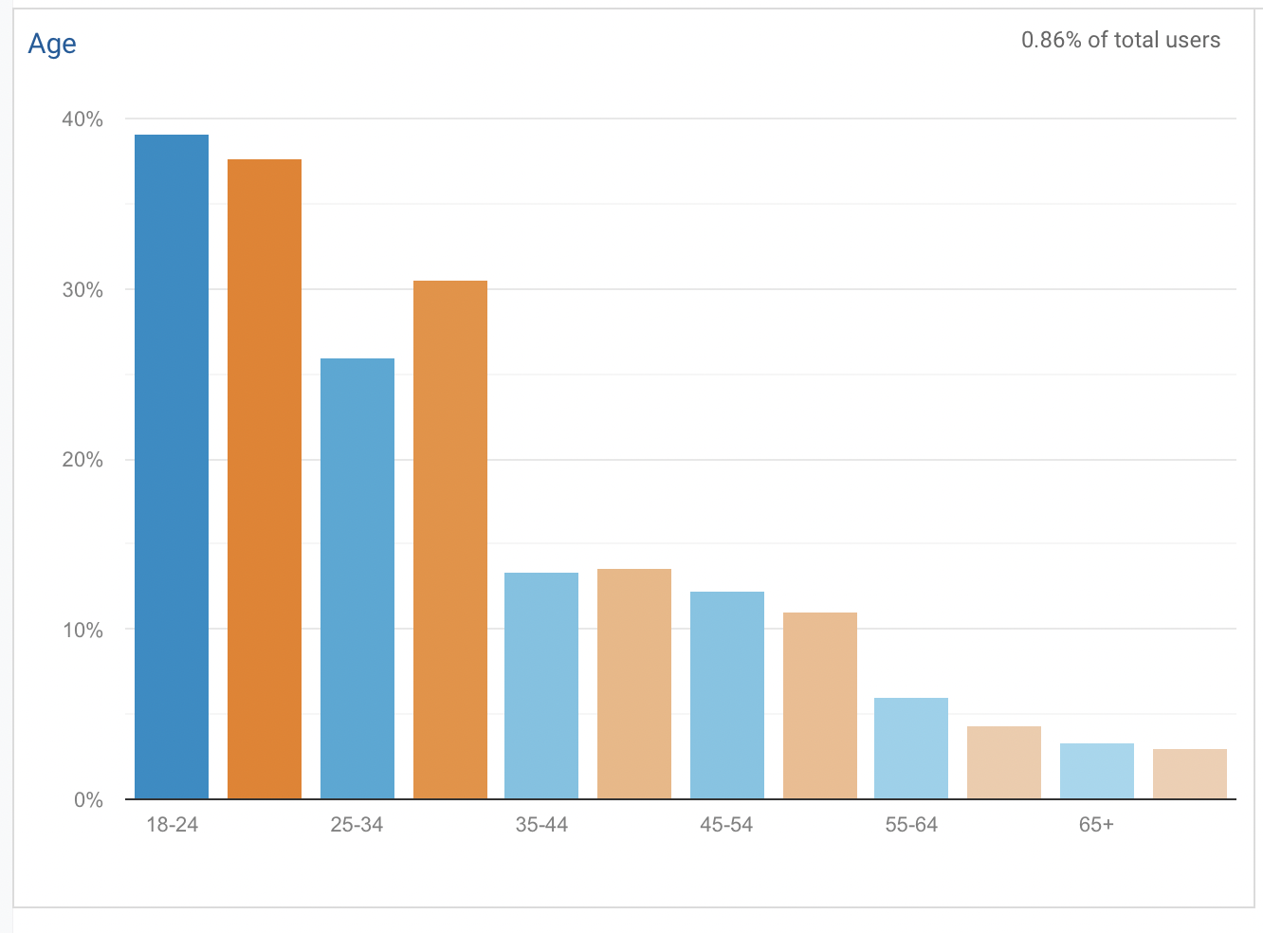
MS Marketing Research
Audience Overview
Aug 20, 2022 – May 14, 2023
Aug 2021 – May 14, 2022
New Users
RFI Submissions*
Users
10,566
9,023
169
-19.16%
-23.27%
-10.58%
13,070
11,760
189
Highest decrease in users between 25-34 age group
MSMR – https://broad.msu.edu/masters/marketing-research/
Aug 20, 2022 – May 14, 2023 vs Aug 2021 – May 14 2022
Who will make business happen, Spartans Will
Notes:
RFI Submissions = Goals Completed

Slide 3
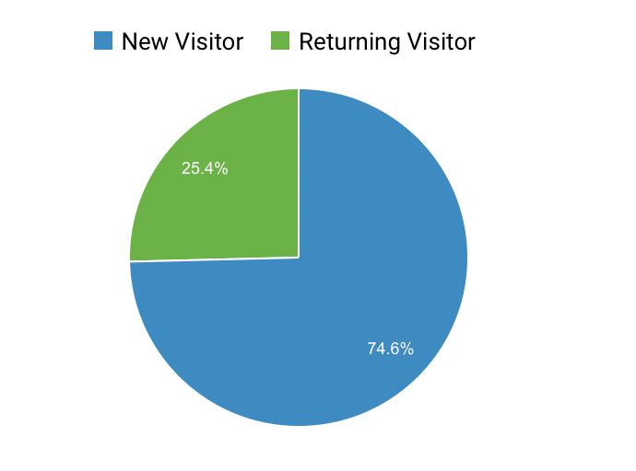
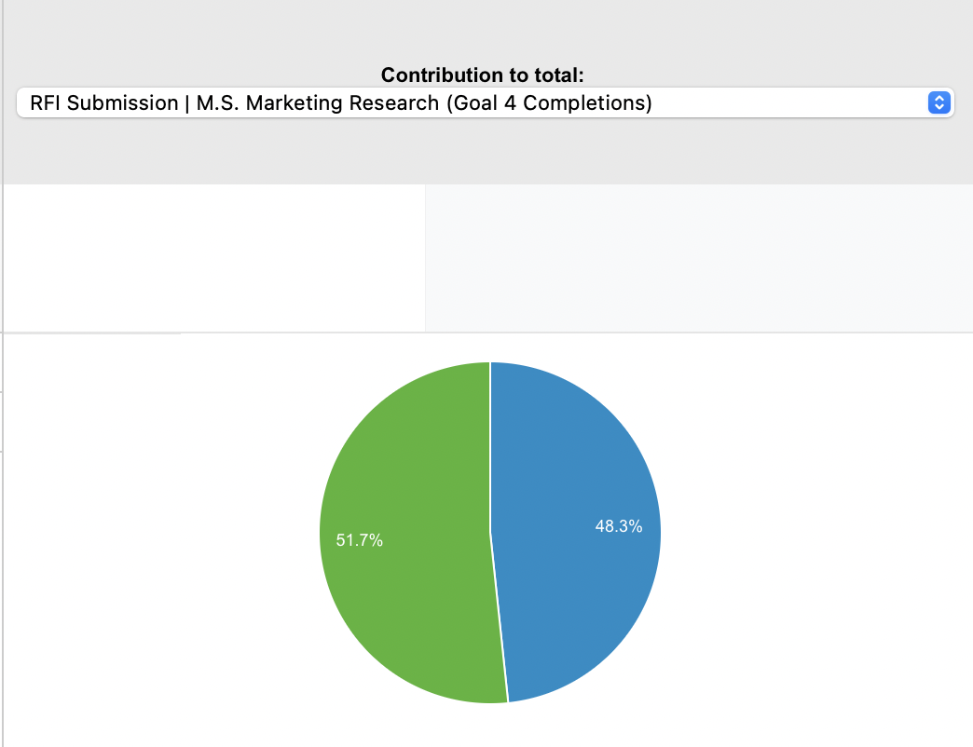
MS Marketing Research
Audience Overview
Aug 20, 2022 – May 14, 2023
Aug 2021 – May 14, 2022
Bounce Rate
Av. Session Duration
42.93%
04:16
+13.55%
+24.84%
49.66%
03:27
The bounce rate has significantly decreased, which shows more interested crowd is being attracted or better page design / navigation
Significant increase in avg. session duration
New vs Returning Visitors
Goal conversion, %, of new vs returning visitors
MSMR – https://broad.msu.edu/masters/marketing-research/
Aug 20, 2022 – May 14, 2023 vs Aug 2021 – May 14 2022
Who will make business happen, Spartans Will
Notes:
Recommendations:
Frequent Content Updates: Implementing regular content updates on the website, such as Program News, Upcoming Event updates, and showcasing faculty or student achievements. This strategy aims to engage prospective students who frequently visit the site and provide them with additional information to enhance conversion rates.
Expand Online Presence: Incorporating prompts to capture email addresses or displaying pop-ups showcasing MSMR's social media accounts, which can be followed by visitors. This approach facilitates increased connectivity beyond the website and sets the stage for future referral opportunities through these platforms.
Utilize Alumni Testimonials and Career Path Insights: Leveraging testimonials from alumni and highlighting successful career paths associated with the program. This tactic serves to enhance credibility and provide prospective students with valuable insights into the potential outcomes and benefits of pursuing MSMR.

Slide 4




MS Marketing Research
Market Segmentation
Geographical
Demographic
This type of segmentation utilizes information about country, state, city, climate, and population density. We primarily focused on country, state, and city
Using demographic factors such as age, gender, occupation income, marital status/ family situation, education, and ethnicity. We looked at Age, and gender is not a significant differentiator in this case
Behavioral
Psychological
Basis how the customer behaves, especially in interactions with the company through their purchase history and frequency, usage patters, brand loyalty, satisfaction and engagement
Define a customer through their personality traits, values, attitudes, interests and lifestyle. Here we considered the “Interests” of our target customer group
MSMR – https://broad.msu.edu/masters/marketing-research/
Aug 20, 2022 – May 14, 2023 vs Aug 2021 – May 14 2022
Who will make business happen, Spartans Will

Slide 5
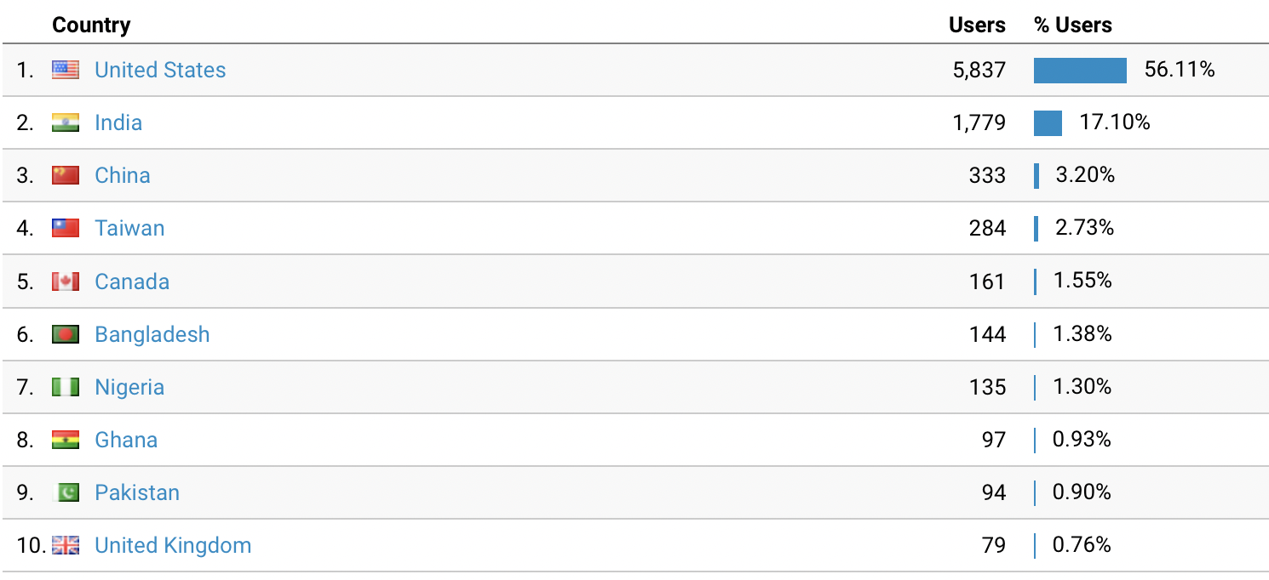
MS Marketing Research
Market Segmentation: Geography
Users: Country | Users: City |  | Conversions: Country | Conversions: City
United States | East Lansing |  | India | Hyderabad
India | Mumbai |  | India | Mumbai
United States | Ashburn |  | United States | (not set)
United States | (not set) |  | United States | Grand Rapids
China | (not set) |  | United States | White Plains
Taiwan | (not set) |  | United States | Lansing
United States | Chicago |  | United States | New York
United States | Lansing |  | India | Delhi
India | Hyderabad |  | Nigeria | Lagos
United States | New York |  | Turkey | Istanbul
Upon initial analysis, the United States appears to be the primary market in terms of user count.
However, delving into a more granular level of analysis at the city level, the top 10 locations emerge as follows:
Basis the report above and left, we would focus our efforts on the following geographies: United States, India, China, Taiwan, and Nigeria.
Expect for the US, the tables above give us an insight on the cities / regions to target within the country. A deeper dive for the US market in the next slide since it is the largest segment.
MSMR – https://broad.msu.edu/masters/marketing-research/
Aug 20, 2022 – May 14, 2023 vs Aug 2021 – May 14 2022
Who will make business happen, Spartans Will
Notes:
Analysis:
The United States exhibited the highest number of users, followed by India, China, Taiwan, Canada, Bangladesh, Nigeria, Ghana, Pakistan, and the United Kingdom. Given the considerable size of these countries, we opted to incorporate city-level data to further refine our targeting criteria. Without this inclusion, our efforts would have encompassed a vast and diverse range of global regions.

Slide 6
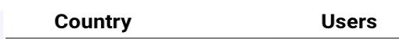
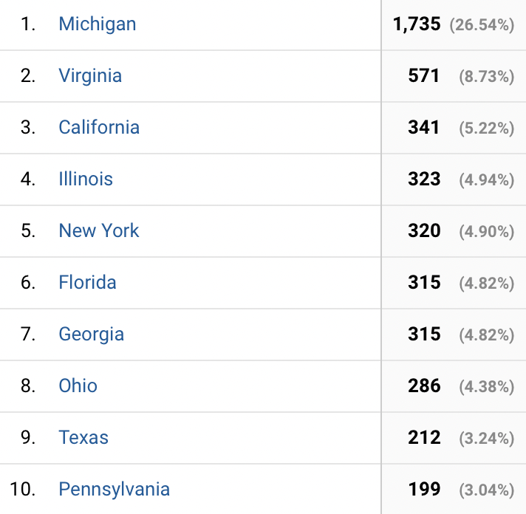
MS Marketing Research
Market Segmentation: Geography (US)
Users: State | Users: City |  | Conversions: State | Conversions: City
Michigan | East Lansing |  | Michigan | Grand Rapids
Virginia | Ashburn |  | New York | White Plains
Illinois | Chicago |  | Michigan | Lansing
Michigan | Lansing |  | New York | New York
New York | New York |  | Florida | Jacksonville
Michigan | Meridian Charter Township |  | Georgia | Atlanta
Georgia | Atlanta |  | Michigan | East Lansing
Michigan | Grand Rapids |  | Michigan | Meridian Charter Township
Michigan | Detroit |  | Arkansas | Little Rock
California | Los Angeles |  | Arizona | Phoenix
State
Based on the afore mentioned report and analysis, our focus will be directed toward the following states: Michigan, Illinois, Georgia, New York, and Virginia.
Further examining the city-level data, we have gained valuable insights indicating the importance of targeting Michigan and its neighboring states.
MSMR – https://broad.msu.edu/masters/marketing-research/
Aug 20, 2022 – May 14, 2023 vs Aug 2021 – May 14 2022
Who will make business happen, Spartans Will

Slide 7
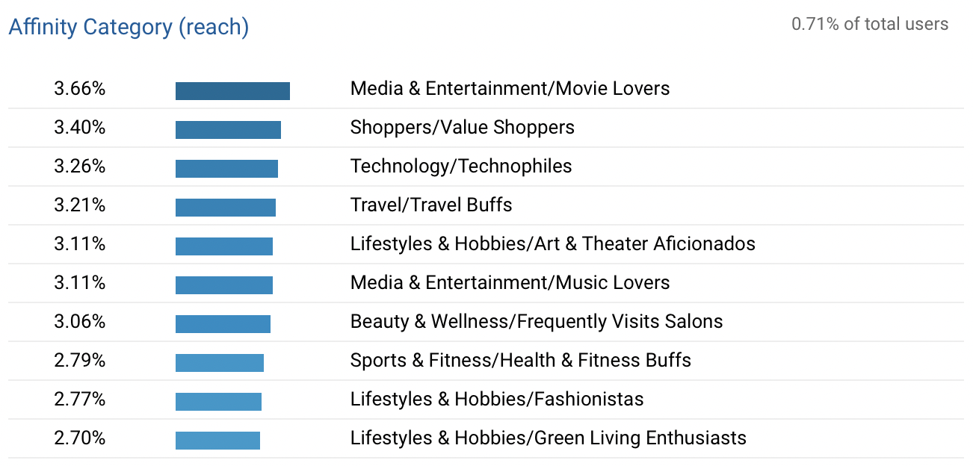
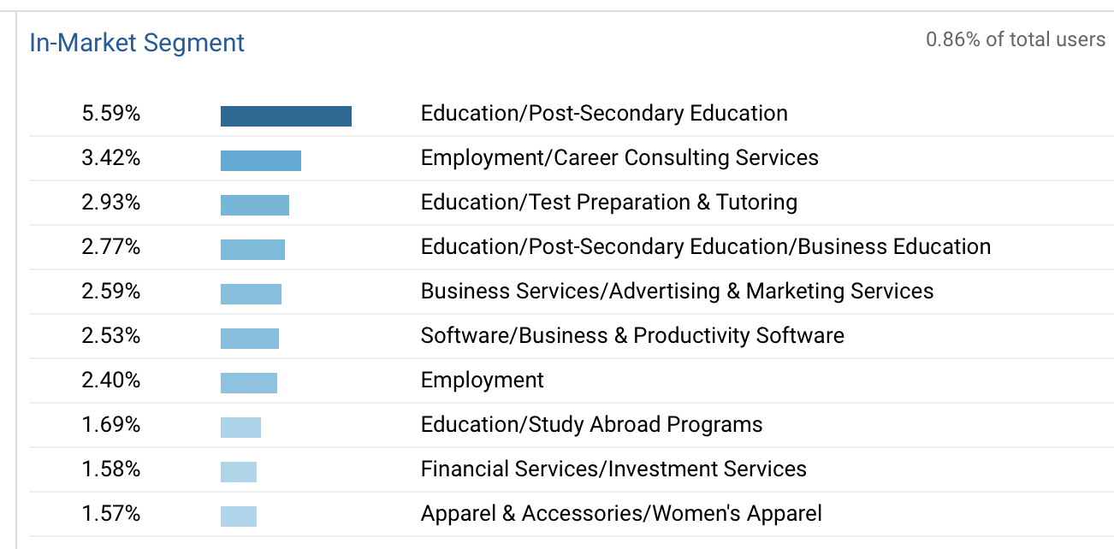
MS Marketing Research
Market Segmentation: Behavioral
Two broad affinity categories emerge: Media & Entertainment and Lifestyle & Hobbies
Two broad affinity categories emerge: Education and Employment
MSMR – https://broad.msu.edu/masters/marketing-research/
Aug 20, 2022 – May 14, 2023 vs Aug 2021 – May 14 2022
Who will make business happen, Spartans Will
Notes:
Recommendations
Category and Course: The website can prominently feature notable live or academic projects, job/internship opportunities, research initiatives, and case studies completed by faculty members and students in these two specific categories.
Partnership/Collaboration: To attract a larger user base, the program should proactively seek partnerships and collaborations with companies operating in these fields. This approach can foster mutually beneficial relationships and enhance the program's reputation and visibility.
Analysis:
From the Affinity Category, it might be helpful to focus on categories that help differentiate the users in a significant manner. For example, a lot of prospective students might identify as Movie / Music Lovers, and this might not help us improve our targeting in any way. But categories like “Lifestyle & Hobbies” which has “Art & Theater Aficionados, Fashionistas, and Green Living Enthusiasts help us narrow down our target segment better.

Slide 8
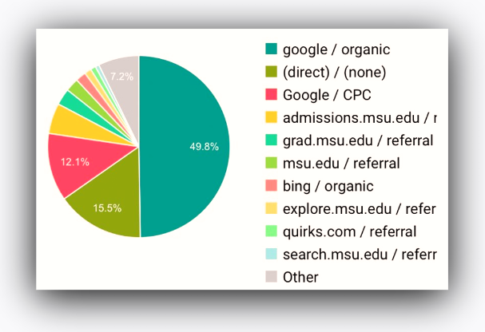
MS Marketing Research
Summary: Source/Medium(Increasing Users and Conversions)
1
2
Quirks.com, place for the “best, brightest and boldest” in marketing research, is amongst the top 10 in both the years. It lists out top marketing research degree programs.
2021-22 also had Green books/display amongst the top 10 Sources/Medium for new users
Advertising how good the program is not only on the program website, but other common places where students search for the best programs, however the number of users for this were too small to make this a responsible conclusion
3
4
MSU should advertise the collaborations by their faculties and encourage to improve them
MSU should advertise its ranking amongst different ranking platforms. Some suggested platform basis the Analytics reports:
collegeconsensus.com,
bestcollegereviews.org,
distinct-education
MSMR – https://broad.msu.edu/masters/marketing-research/
Aug 20, 2022 – May 14, 2023 vs Aug 2021 – May 14 2022
Who will make business happen, Spartans Will

Slide 9
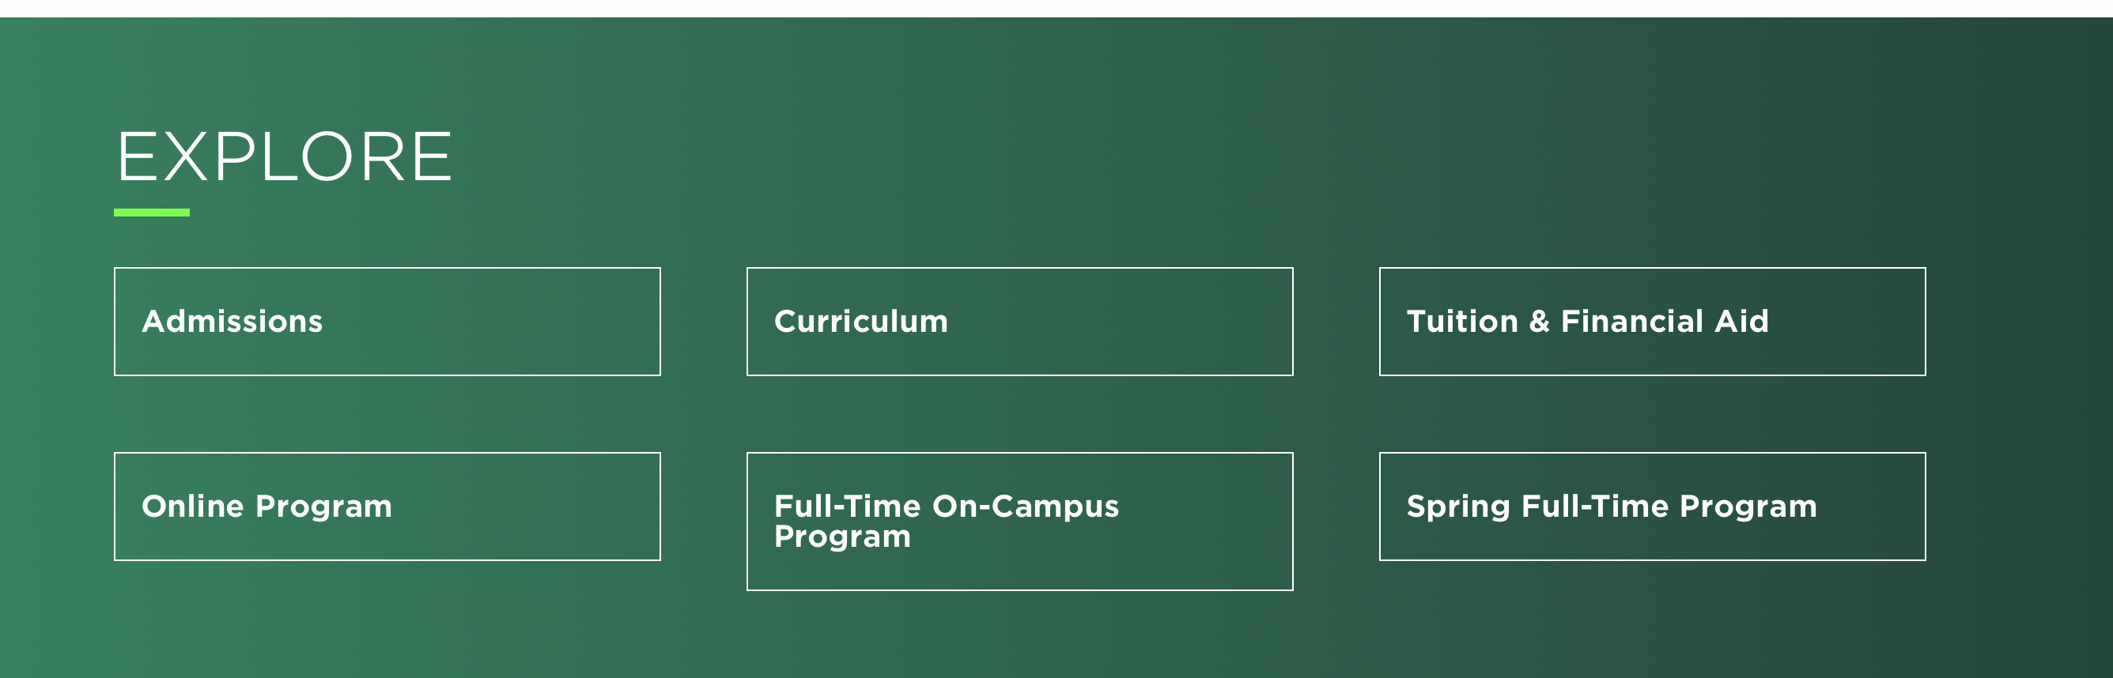
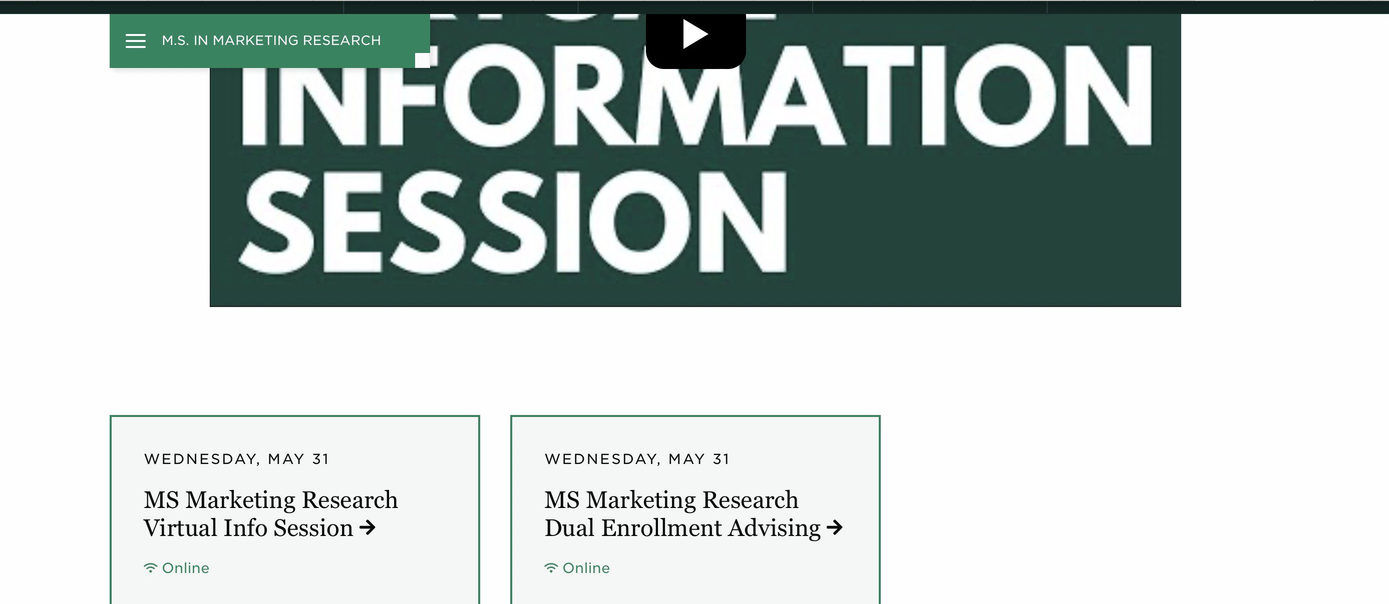
MS Marketing Research
Summary: Landing Page (Improve CTA)
Improve call to action (CTA):
Include the request for information in the key statistics area
Or include it in the upcoming events schedule using “Can’t find an event, request for info”
Make the request for info form available on the same page, to show that the user does not have to fill a lot of information
Perform A/B testing to test out the best landing page
Ask for site feedback
First Name*
Last Name*
Email*
Phone
Country*
State
City
Didn’t find what you’re looking for? Request Info!
Suggested
MSMR – https://broad.msu.edu/masters/marketing-research/
Aug 20, 2022 – May 14, 2023 vs Aug 2021 – May 14 2022
Who will make business happen, Spartans Will

Slide 10

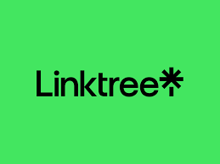
MS Marketing Research
Summary: Increasing users and conversions through social media
LinkedIn is the only social media platform in the top 10 for bringing referral traffic to the site. From 4.8% in 2021-22 to 2.02% in 2022-23, there has been a decrease and there is no conversion
Conclusion: Social media might be a good option to increase mind space and recall of MSU programs. However, given the nature of selecting higher education programs, which include extensive research and multiple touchpoints, social media might not drive the desired results.
Remarketing Campaigns: Implement remarketing campaigns on Facebook to re-engage with users who have previously visited the website. Tailor the messaging and offers to address any potential concerns or barriers that prevented conversion initially.
Refine the audience on Facebook
MSMR – https://broad.msu.edu/masters/marketing-research/
Aug 20, 2022 – May 14, 2023 vs Aug 2021 – May 14 2022
Who will make business happen, Spartans Will

Slide 11
3
Appendix
broad.msu.edu/
Aug 20, 2022 – May 14, 2023 vs Aug 2021 – May 14 2022
Who will make business happen, Spartans will

Slide 12
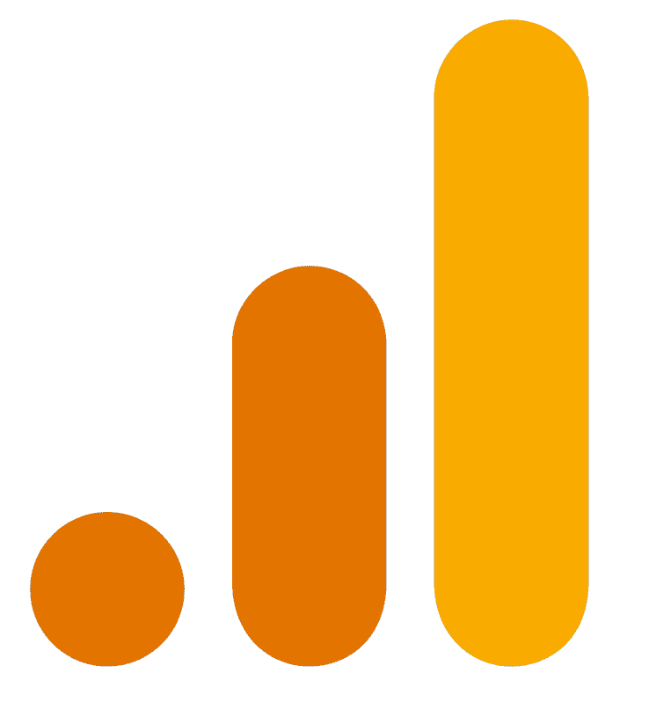
Google Analytics
(Definitions - i)
Audience
Users
New Visitors
Website visitors who have initiated at least one session during the date range August 20, 2022, to May 14, 2023, compared to the same period in the previous year.
The number of users that visited broad.msu.edu/ for the first time on a specific browser/device in the selected date range.
Session
Returning Visitors
The period a user is actively engaged with broad.msu.edu/.
Users who have visited broad.msu.edu/ in the past two years on the same browser/device.
Av. Session Duration
Bounce rate
The percentage of single-page sessions in which there was no interaction with the page. A bounced session has a duration of 0 seconds.
The percentage of single-page sessions in which there was no interaction with the page. A bounced session has a duration of 0 seconds.
broad.msu.edu/
Aug 20, 2022 – May 14, 2023 vs Aug 2021 – May 14 2022
Who will make business happen, Spartans Will

Slide 13
Google Analytics
(Definitions -ii)
Traffic Source
Source
Direct
Shows where users were before visiting broad.msu.edu/, such as a search engine or another website.
user types/pastes the URL directly clicks a bookmark, or clicks a link GA cannot identify, such as links from instant messaging apps (iMessage, Facebook Messenger, or WhatsApp), and offline documents (PDF or Word).
Medium
Shows how users arrived at broad.msu.edu, such as "organic" for unpaid search traffic and "(none)" for direct traffic.
Organic
Traffic to broad.msu.edu/ through unpaid search engine results.
CPC
Cost per click. It represents the cost paid each time a user clicks on an ad. In this context, it refers to users acquired from paid search.
Referral
Traffic to broad.msu.edu/ from sources outside a search engine
broad.msu.edu/
Aug 20, 2022 – May 14, 2023 vs Aug 2021 – May 14 2022
Who will make business happen, Spartans Will

Slide 14
Google Analytics
(Definitions -iii)
Goal Conversion
Market Segmentation
Goal Completion
Affinity Category
When a visitor completes a request for information (RFI). A user who views the “RFI Thank You” page has completed a goal.
This indicates that users are more likely to be interested in learning about these categories.
Goal Conversion Rate
In-Market Segment
The percentage of visits or sessions that results in a conversion to the goal.
This indicates that users are more likely to be ready to purchase products or services in the specified categories.
Landing Page
The landing page is the first page viewed during a session.
Entrance
The number of times users entered the site through a specified page or set of pages.
Entrance
The number of times users entered the site through a specified page or set of pages.
broad.msu.edu/
Aug 20, 2022 – May 14, 2023 vs Aug 2021 – May 14 2022
Who will make business happen, Spartans Will

